Slide 1







VAS POLYMERS
LLP
www.vaspolymers.com

Slide 2



Agenda
01
02
03
04
05
06
07
About Us
Mission
Vision
Engineering Capability
Products
Customers
Contact

Slide 3

About US
We found our business in 2020- Looking at demand of manufacturing sector, Today customer needs is one
touch solutions decade, where they can
get complete services.
We as a VAS Polymer is working to serve customer right from Development to manufacturing in any kind of Polymer range molded products with zero defect.
What we do-
Manufactures of plastic Components of all kind of Plastics products.
Product Design development.
Mould & Tool Development
Mould maintenance

Slide 4





Vision Mission & Value
Vision
We will strive to become a Top companies by diversification & expansion of our business in domestic as well as export market by year 2025.
Value
Integrity
Excellence
Customer Centricity
Winning through team work Trust
Mission
Our Mission is to be a World Class, Cost Effective Component Solution Provider for Auto and Non- Auto segments as a Preferred Partner for Mutual Success.

Slide 5






Our Values
Winning through team work
Integrity
Excellence
Customer centricity
We at VAS Polymers LLP are committed to fair, honest and ethical in our work.
We will be passionate about achieving the highest standard of quality and always work towards minimum wastage.
We focus on customer satisfaction by improving our services and quality .
We will invest in our team members and partners, learning, caring and collaborative relation based on truth and mutual understating.
AN IATF AND ISO CERTIFIED ORGANISATION

Slide 6





Milestone
2020
2021
2022
2023
2024
Plant Establishment and registration
Addition of business and own product development
Self assessment and improvement to start business for automotive.
Standardization and certification work
Increased Manufacturing capacity of plant

Slide 7

Engineering Capability
Molding
01
Injection Molding up to 300T.
Insert molding capability.
Eng. material processing skills and experience
02
ASSEMBLY
Ultrasonic Welding.
FOAM ASSEMBLY
BOP ASSEMBLY
03
TOOLING
Manufacturing feasibility &
Tool design
Injection Mould manufacturing ,
Mold maintenance facility.
04
BUSINESS RELATION
Have a strong footprints in Automotive Industries, catering business to Indian OEM’S & Tier 1 Suppliers.

Slide 8
MOLDING CAPACITY
MOLDING MACHINE SPECIFICATIONS
Machine Tonnage (tons) | SPECIAL INSTRUCTION WILL APPEAR IN THIS AREA |  | 160 T | 120 T | 300 T | 450T*
Manufacturer |  |  | Haitian | HAITIAN | HAITIAN | Millacron
No of Machine available |  |  | 1 | 1 | 1 | 1
Machine Details
Controller Type |  |  | PLC Type | PLC Type | PLC Type | PLC Type
Year Of Manufacture |  |  | 2021 | 2024 | 2021
Clamping Unit | UOM
Clamping Force | Ton |  | 160 | 120 | 300 | 450
Tie bar Distance (H X V) | mm |  | 455*455 | 410*410 | 660*660 | 830*830
Overall size of platens (H X V) | mm |  | 630*630 | 605*605 | 955*955 | 1200*1200
Mould opening distance (stroke) | mm |  | 420 | 350 | 660 | 1500
Tie Rod Diameter | mm |  | 75 | 75 | 85 | 140
Max Day Light | mm |  | 500 | 430 | 660 | 1500
Mould Height Min | mm |  | 180 | 120 | 200 | 400
Mould Height Max | mm |  | 500 | 430 | 660 | 1100
Locating Ring Dia | mm |  | 100 | 100 | 160 | 150
Platen Type | mm |  | T Slot | T Slot | T Slot | T Slot
Ejection Stroke | mm |  | 140 | 120 | 160 | 200
Ejection Force (Forward) | KN |  | 33.00 | 33 | 62 | 11.5
Injection Unit
Screw Dia | mm |  | 45 | 40 | 65 | 80
Shot Weight(PS) | G |  | 292 | 214 | 903 | 2179
Injection Pressure | bar |  | 169 | 171 | 182 | 1456
Injection Rate | Cm^3/s ec. |  | 140 | 110 | 279 | 603
Plasticizing capacity | g/sec |  | 22 | 15.8 | 35 | 85
Injection Stroke | mm |  | 250 | 180 | 400 | 360
L/D ratio | L/D |  | 20:1 | 20:1 | 20:1 | 20:1
Nozzle spherical radius ® | mm |  | R 19 | R 19 | R19 | R12
Nozzle hole (DIA) | mm |  | 3 - 5 | 3.00 | 4.00 | 4

Slide 9
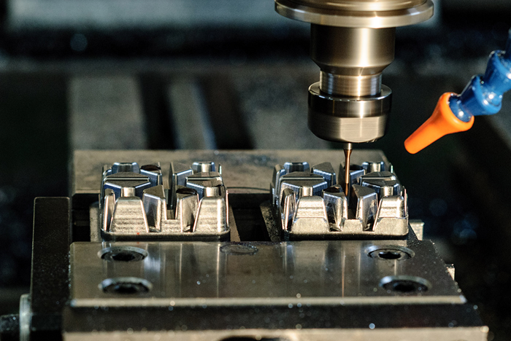
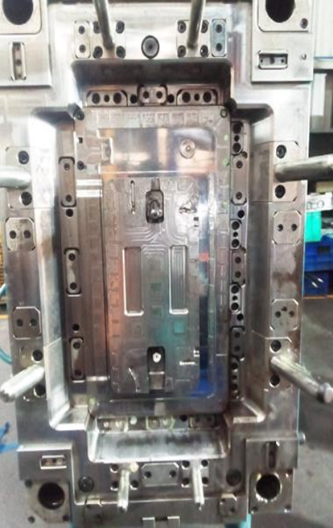
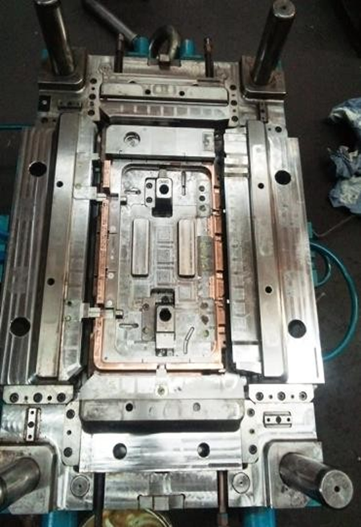
MOLD MAINTAINANCE /TOOLING FACILITY

Slide 10



BUSINESS STRATGY
SUSTENANCE STRATEGY
SWOT Analysis
01
Business
Financial Review
Customer Relations
Customer Connect
Research and Development
Process
QS
PS
DWM
QRM
Best Practices
People
Leadership
Development
Training & Development
Rewards & Recognition
Stability
02
03

Slide 11


Our Best Practice
 | Sr. No. | Improvement Area | Top Best Practices / Ideas
 | 1 | Quality | Implementation of “Zero Defect Part Supply Concept” Implementation of “DWM –Daily Work Management Concept” Implementation of “Continual Improvement Concept” Implementation of “Chalta Bolta” Concept. Proactive approach for ”May Happen” Defects. 6.Implementation of Kaizen/Pokayoke concept.
 | 2 | Productivity | New machines to be installed with latest technology
 | 3 | Cost | Conversion of maximum corrugated boxes into PP Boxes. Alternate sources for All types of Consumables.
 | 4 | Safety | Capture the data of Unsafe working condition, Unsafe working act & Near miss. Provided “Assembly point” to control any type of Hazard situation
 | 5 | Morale | Implemented the concept of “Man of the Month”. Celebrating Staff’s Birthdays.

Slide 12

Our Manufacturing Reach
01
02
03
04
05
06
07
Two Wheeler
Three Wheeler
Four Wheeler
Pharama
Packaging
Building/Construction
Export

Slide 13


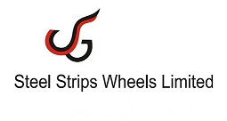





OUR VALUABLE CUSTOMER
Some of our respected customer mentioned here for your reference .
Suntara Cosmetic
Cordial Pharmaceutical
SSW Wheels Ltd
Reciq Engineering Pvt Ltd
Bharat Technoplast
CTM

Slide 14
OUR FUTURE PLAN
Increase Injection Molding Machine Capability up to 550 ton
Increase machine no from 4 to 10 by 2026 .
Increase factory area by 5000 Sq ft 15000 Sq ft.
Become supplier of all OEM’s in Gujrat state.
Develop In-house Mold Design facility.
Develop and design own product supply to market

Slide 15




Thank You!
Contact Us
Phone
9099098834
Mail
info@vaspolymers.com
Website
Everest Cantu
www.vaspolymers.com
Address
Sanand II, GIDC Sanand, Ahmedabad

